Slide 1
Project Report
Analysis of Customer Retention
Submitted by – Shubham Nagpal
Submitted to – Mohd Kashif

Slide 2
Introduction
Business Issue Outlining
Consumer loyalty has arisen as quite possibly of the main element that ensure the progress of online store; it has been placed as a key energizer of procurement or repurchase aims and client steadfastness. A extensive audit of the writing, speculations and models have been completed to propose the models for client initiation and client maintenance. Five main considerations that added to the outcome of an online business store have been distinguished as: administration quality, framework quality, data quality, trust and net advantage. Client maintenance procedures empower you to both give and concentrate more worth from your current client base. You need to guarantee the clients you endeavored to secure stay with you, have an extraordinary client experience, and keep on getting esteem from your items. Subsequently, knowing how to expand the repurchase expectation of Indians online buyers' is imperative for a web-based retailer in India to accomplish its business objectives. This might additionally prompt foster a general reference model for effective internet based retail business. Progress of an internet based retail site relies upon its framework quality and how much shopper inspiration values are gotten through shopping from it.
The exploration besides examined the elements that impact the online clients rehash buy goal. The mix of both utilitarian worth and libertine qualities are expected to influence the rehash buy goal (dependability) emphatically. The information is gathered from the Indian web-based customers. Results demonstrate the e-retail achievement factors, which are especially basic for consumer loyalty.
Conceptual Background of the Domain Problem
An effective business procedure today isn't just creating costeffective and profoundly designated ways of connecting the new clients, it is more about keeping the current clients took part in the organization. It has been recognized that getting new clients is costly. Interest in the securing of new clients is multiple times higher than putting resources into existing clients. Expanded execution in client maintenance rehearses, then again, has been found to make five times more effect than a comparative measure of markdown or cost of the capital, driving into the more beneficial client relationship.

Slide 3
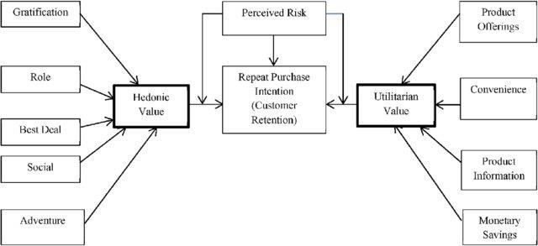
The circumstance in the market has changed, and the opposition has become harder. Clients have the privilege to pick between numerous suppliers. The rising number of entertainers in the market has caused an ascent in the importance and pertinence of client maintenance and the preparation of a client maintenance process is fundamental to accomplish the ideal degree of result not entirely settled in the cutting edge administration. It focuses on the experience of purchasing the preferred product, instead of the product itself.
1.3 Motivation for the Problem Undertaken
The undertaking was the first given to me by Flip Robo Innovations as a some portion of the entry level position program. The openness to genuine information and the valuable chance to convey my range of abilities in tackling an ongoing issue has been the essential inspiration. Our primary goal of doing this task is to examine whether the clients are shopping items from internet business sites. How could they give inputs to these sites based on a few positive and negative factors and furthermore the subtleties of the clients on premise of variables like age, orientation, city and so on.

Slide 4
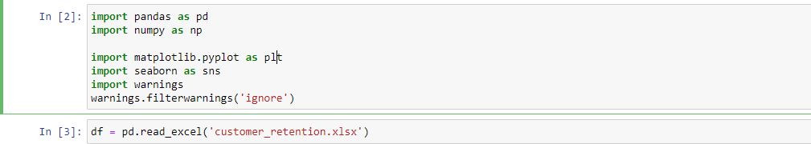
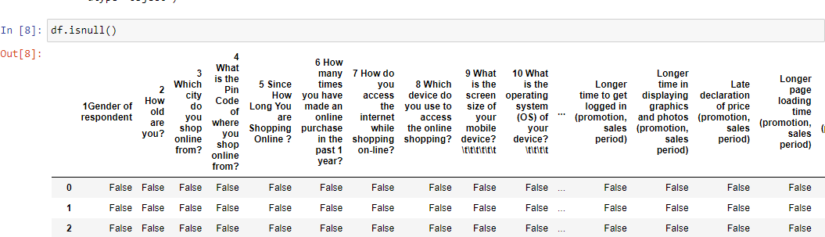
Chapter 2
Analysis of the Given Dataset
1) Downloading the Data
The information is gathered from the Indian web-based customers. Results demonstrate the e-retail achievement factors, which are particularly basic for consumer loyalty. There are two sheets (one is point by point) and second is encoded in the succeed document.
2) Checking Data Integrity
Before process the data we have to check for data integrity. we have to check all columns for null values.
Chap -3 Data analysis and model development
1) Visualization

Slide 5
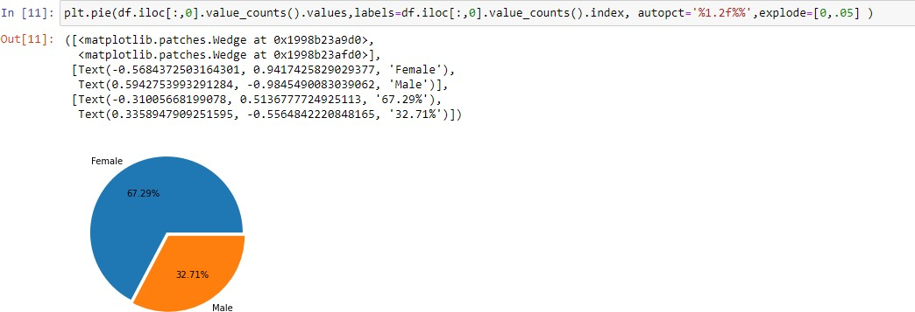
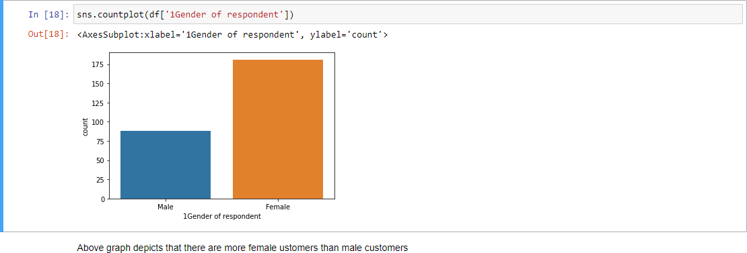
1. General component depicting Populace and internet shopping
How about we start EDA with Orientation dissemination of respondent.
Most of Respondent are Female (67.3%) and rest are Male respondent. This likewise shows that ladies are more shopping focused than men.
Larger part of female clients are between age gathering of 21-40 years.
Inside Male Clients Propensity of web based shopping seen among age gathering of 31-50 years.
For both orientation propensity of shopping is less for age more prominent
than 51 years of age. This might be because of reduction in materialistic propensity with age or conceivable Less TECH-SAVY Age.

Slide 6
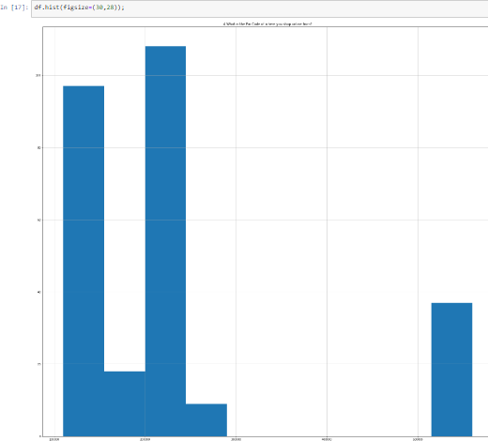
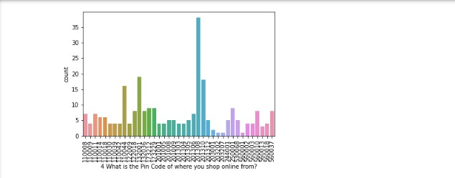

Slide 7
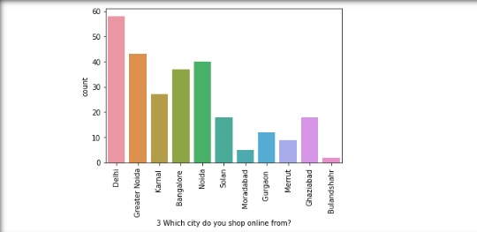
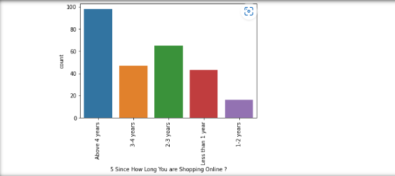
Observations:
Most Internet Shopping Client have a place with Metro Urban communities. also, the majority of them are Male client. We can reason that in Metro city like Delhi, Male have more propensity of web based shopping. shopping stage can focus on this populace in showcasing.
In Level 2 and 3 Urban communities Larger part of web based shopping clients are Females. We can run female item related crusade for this target client populace in these urban communities.
Observation:

Slide 8
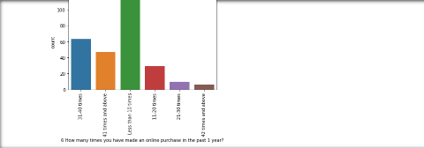
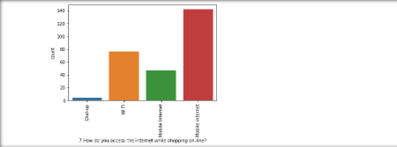
36.4% Respondent shopping online since 4 Yrs.
Most of female shopping since 4 Yrs.
observation:
42.4% Clients in most recent 1 year made web-based buy under multiple times.
Around 19.7% clients have made web based looking for multiple times and more in most recent 1 year. Out which Greater part are females.
One more fascinating perception no female had made shopping in scope of
21-30 times.
Observation:
70.3% Clients are portable web client followed by Wi-Fi Client.
We can see that all clients who made web based looking for multiple times and more are utilizing Portable web.

Slide 9
3. Just 4 clients are utilizing Dial up Association and every one of them made internet looking for under multiple times.
Other Important observations from the data are:
Observation:
50.2% Client unequivocally concur and 36.4% client concur that for good internet shopping total and pertinent item data.
Around 83% client seek after web based looking for Financial Investment funds.
For 37.5 % clients Web based shopping on site firmly gives the feeling of experience.
We can see various people groups have various sentiments about association between e-rear and societal position. Same with delight on most loved e- posterior.
55.4% individuals firmly concur and 30.5% individuals concur that they incline toward web based shopping since they get worth of cash spent.
Investigating Assessment on Web based Shopping Stage Sites by Client
In this part we will break down highlights connected with site or application like execution, web format. Following elements, we have examined in this segment:
Simple to utilize site or application
Visual engaging page design
Wild assortment of item on offer
Complete, pertinent portrayal data of items
Quick stacking site speed of site and application
Dependability of the site or application
Speed to finish buy
Accessibility of a few installment choices

Slide 10
Expedient request conveyance
Security of clients' data
Security of client monetary data
Seen Reliability
Presence of online help through multi-channel
Longer chance to get signed in (advancement, deals period)
Longer time in showing illustrations and photographs (advancement, deals period)
Late announcement of cost (advancement, deals period)
Longer page stacking time (advancement, deals period)
Restricted method of installment on most items (advancement, deals period)
Longer conveyance period
Change in site/Application plan
Incessant interruption while moving starting with one page then onto the next
Site is pretty much as proficient as in the past
Which of the Indian web-based retailer could you prescribe to a companion?
33 Venture Report on Information Examination of Client Maintenance in Web based business Area
Greater part, 64 clients concur that Amazon.in, Flipkart.com, Paytm.com, Myntra.com, Snapdeal.com are Not difficult to utilize site or application. However, generally assuming we see count plot of simple to-utilize application and site Amazon.in got exclusively first Position.
87 clients concur that Amazon.in, Flipkart.com have Visual engaging website page format than a large portion of other market players.

Slide 11
Around as indicated by 125 individuals Amazon.in, Flipkart.com gives wide assortment of proposition on item.
We definitely know 50.2% Emphatically concur over giving total applicable item data, and here we can see that 100 client feel that Amazon.in, Flipkart.com gives total data contrast with others.
Beforehand we know that 42.8 % client unequivocally concur and 41.6 % client concur over high stacking and handling pace of site. Here we can see Greater part of individuals believe that stacking velocity of Amazon.in is quickest while Flipkart.com slowest site to stack.
As far as Unwavering quality of site or application again Amazon top rundown.
Greater part of individuals likewise imagine that Amazon.in tops the graph as far as speed buy process contrast with others.
Larger part of clients believe that Amazon.in, Flipkart.com gives a few installment choices contrast with others.
Safe and Speed conveyance particularly game changer regarding buy. As far as speed of conveyance Amazon.in is far superior to other web based shopping stage and Flipkart.com most terrible among all concerning speed conveyance of item. • We definitely Realize over 90% Client feels that assurance on protection of their data is significant for them. Greater part of clients trust Amazon.in more than other shopping stage for Protection of clients' data • Larger part of client trust Amazon.in followed by Flipkart.in over Security of their monetary data. We additionally see not very many people groups trust installment stage Paytm.
Amazon.com
Regions for additional improvement:
During advancements, attempt to give an unsettling influence free shopping experience to clients.
Give greater installment choices to clients.
Attempt to give cost ahead of schedule during advancement.
Decrease the conveyance season of the items.
Solid Region as per input by client:

Slide 12
Helpful to utilize and furthermore a decent site for shopping.
Quick conveyance of items.
Accessibility of complete data of the items.
Presence of online help through multi-channels.
Solid site or application, saw reliability.
Flipkart.com
Regions for additional improvement:
Attempt to give the cost right on time during advancement.
Diminish the conveyance season of the items.
Flipkart and Amazon nearly share similar criticisms with changing rates as the main contrast.
Solid Region as indicated by input by client:
Helpful to utilize and furthermore a decent site for shopping.
Quick conveyance of items.
Accessibility of complete data of the items.
Presence of online help through multi-channels.
Solid site or application, saw dependability.
Wild assortment of items to offer.
Myntra.com
Regions for additional improvement:
During advancements, attempt to give an unsettling influence free shopping experience to clients.
Attempt to give the cost ahead of schedule during advancements.
Decrease the conveyance season of the items during advancements.
Solid Region as per criticism by client:
Helpful to utilize and furthermore a decent site.
Accessibility of a few installment choices.
Quicker items conveyance.
Complete data of items accessible.
Solid site or application, saw reliability.

Slide 13
Conclusion
Solid proposal to organizations Don't spend more cash over virtual entertainment promoting and Show Adverts in their Computerized Advertising effort rather than that attention on Site design improvement and Email Promoting which will prone to be more successful to prior.
Complete depiction item on site or application is fundamental from settling on buy choice.
For both orientation inclination of shopping is less for age more prominent
than 51 years of age.
The greater part of them concurs that the working of application proficiently is likewise a central point which assists in improve client with encountering
while at the same time doing web based shopping.
Around half clients forsake truck because of better elective proposition
which is clear explanation. Another most normal explanation is promotion code not pertinent on specific item.
Paytm and Snapdeal has unfortunate client administrations and there is parcel of degree for additional improvement.
Amazon and Flipkart are standing best out in the market skilled business systems and part benefits around there contender.
Generally in light of the fact that, it is helpful and adaptable, individuals favor web based shopping.
Individuals who have been looking for additional then 3-4 years are the
ones who regularly shops.
We can see that a large portion of individuals, deserted them truck as they were having better elective offers
To close, having the right client maintenance methodology will stay with merchants developing assuming they know how to exploit it. Then clients will see as their way back and keep purchasing stuff from the best
organization.

